Slide 1
GAMP5 Overview: “A Risk-Based Approach to Compliant GxP Computerised Systems
COVEX LLC

Slide 2


Purpose of this Training
Help understand the GAMP5 Methodology specific to Computerised System Validation (CSV) and Infrastructure Qualification
Define the GAMP5 System Development Lifecycle (SDLC) as part of an overall Quality Management System (QMS) and highlight documentation and activities in each Lifecycle Phase
Introduce Quality Risk Management and its impact on each SDLC Phase
Understand the Roles and Responsibilities for delivering systems in compliance with GAMP5 practices
Mapping GAMP4 to GAMP5 (what changed)

Slide 3
Presentation Index
Background
GAMP5 Hierarchy
GAMP5 Structure
Key Concepts
Categories – Software
Categories – Hardware
CSV / Qualification Methodology
System Development Lifecycle Phases
Quality Risk Management
Concept Phase
Business Process Development/CPPs
Assessments
Supplier Evaluation / Quality Agreements
Project Phase
Planning Stage
Specification Stage
Configuration/Coding Stage
Verification Stage
Reporting/Release Stage
Operation Phase
System Operational Procedures
Training
Change Management
Periodic Review
Retirement Phase
Approvals Matrix (RACI)
Notes:
Hyperlinks to jump to specific topics within the training

Slide 4

Background
GAMP Guidance aims to achieve computerised systems that are fit for their intended use and meet current regulatory requirements, by building upon existing industry good practices in an efficient and effective manner.
Facilitate the interpretation of regulatory requirements
ICH Q7,Q8, Q9, and Q10
US FDA GMPs (21 CFR Parts 11, 210 and 211)
EudraLex Volume 4 Annex 11
Pharmaceutical Inspection Cooperation Scheme (PIC/S)
Establishes a common language and terminology
Promotes a system life cycle approach based on good practices
Clarifies roles and responsibilities

Slide 5
Background
Why do we need it?
Need a consistent approach across sites, especially for Global Systems
Need consistent terminology and approach
Need to be more efficient
“Right-size” testing and documentation based on system novelty, complexity, and risk (Qualification vs. Validation)
“Right-skill” IT compliance oversight for technical testing activities vs Quality oversight for processes, specifications, plans, reports, and procedures.
Leverage Supplier Activities based on Supplier Audit
Need to leverage best practices
Industry best practices
Client IT and Quality best practices
Remember GAMP5 is a GUIDELINE!

Slide 6
Introduction
The GAMP Guide has been significantly updated to align with the concepts and terminology of recent regulatory and industry developments
Updates address changing environment while still satisfying current international GxP regulatory expectations. Represents current industry good practices and remains compatible with principles presented in GAMP 4
Scope widened to include related industries and their suppliers, including biotechnology and systems used in medical device manufacturing
Key Drivers for GAMP 5 - patient safety, product quality, and data integrity

Slide 7
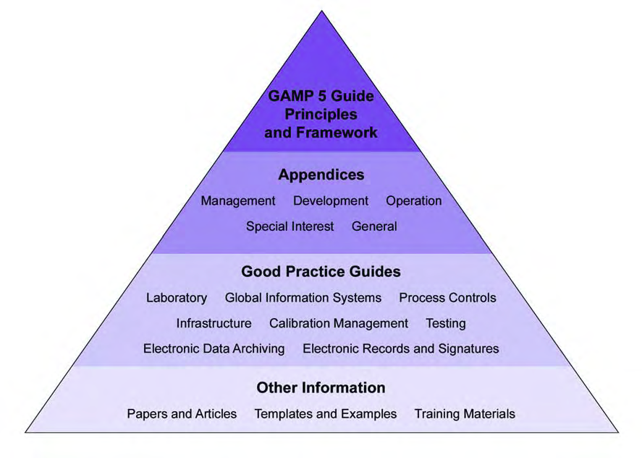
GAMP5 Hierarchy
GAMP5 Figure 1.2: GAMP5 Documentation Structure

Slide 8
GAMP Structure
GAMP 5 is a family of documents and the Guide acts as the main body
Provides principles and life cycle framework applicable to all GxP regulated computerized systems
Contains Appendices for:
Management
Development
Operation
Special Interest
General

Slide 9
What Changed from GAMP4?
Emphasis on cost effective approach to compliance and demonstrating fitness for use supported by:
Complete SLC approach as part of QMS
Scalable approach per novelty, complexity, and risk (patient safety, product quality, and data integrity)
Quality Unit role clarification
New roles for Process Owner, System Owner, and Subject Matter experts
Stressed importance of clear and accurate requirements – based on understanding of science
Leveraging of supplier documentation and knowledge
Promotion of practical and effective interpretation of GAMP guidance
Maximize use of documentation from activities such as development and commissioning as verification evidence
Importance of effective governance
Identifying opportunities for process and system improvements based on periodic review, root-cause analysis, and CAPA

Slide 10
GAMP 5 Key Concepts
Key Concepts – overview of approach
Life Cycle Approach detailed – encompasses all activities: initial concept, to understanding the requirements through development, to release, to operational use, and through system retirement
Lifecycle Phases consolidated to only 4:
Concept
Project
Operation
Retirement
Section describes process as a whole and how each activity relates to the other
Comparable to the GAMP 4 section 6 – “Validation Overview” but is much deeper and structured towards the entire process (again, phases are consolidated to only 4)
Section 3.3 includes CSV Framework

Slide 11
GAMP 5 Key Concepts
‘Project’ Life Cycle Phase is expanded upon
Described in 5 “Stages”
Planning
Specification
Configuration and Coding
Verification
Reporting and Release
Practical examples provided
Operational phase significantly expanded upon (was once just left as “control system through SOPs”)
Key supporting processes of risk management, change and configuration management, design review, traceability, and document management are introduced

Slide 12
GAMP 5 Key Concepts
Quality Risk Management – systematic approach for the assessment, control communication, and review of risk to patient safety, product quality, and data integrity
Corporate threshold for risk varies – must be agreed to between QA and business areas
Iterative process applied throughout the entire system life cycle
Assess systems and functions/specifications

Slide 13
GAMP 5 Key Concepts
Regulated Company Activities:
Governance framework covering policies, responsibilities, management and continued improvement
System specific activities
Company is responsible for ensuring compliance and fitness for purpose of systems
Must be documented, approved, effective and consistent

Slide 14
GAMP 5 Key Concepts
Supplier Activities
Supplier good practice activities and expectations
Vendor Management and auditing program
Efficiency Improvements – fit for use, effective application of framework, etc.
GAMP 5 main body does not contain separate guidance sections for IT or Process Control systems (or for any specific type of system for that matter) –particular aspects of specific system types to be covered by GPC’s (Good Practice Guides)

Slide 15
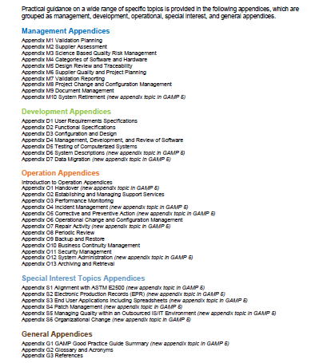
Appendices

Slide 16
Management Appendices Changes
M2 “Guideline for Supplier Audit”
Expanded to “Supplier Assessment”
Now includes audit guidance based on risk, complexity and novelty
M3 “Guideline for Risk Assessment”
Expanded to “Science Based Quality Risk Management”
Now includes quality risk management process and numerous examples
M4 “Guideline for Categories of Software and Hardware”
Categories refined and re-organized
M5 “Guideline for Design Review and Requirements Traceability Matrix”
Expanded to “Design Review and Traceability”
Recognizes that RTM is only one valid method of many
M6 “Guideline for Quality and Project Planning” is now “Supplier Quality and Project Planning” – reflects new focus on suppliers
M8 “Guideline for Project Change Control” and M9 “Guideline for Configuration Management” combined into new M8 “Project Change Management and Configuration Management”

Slide 17
Development Appendices Changes
D1 “Example Procedure for the Production of a User Requirements Specification” is now a guidance instead of example – emphasis on requirement “capture”
D2 “Example Procedure for the Production of a Functional Specification” is now a guidance instead of example
D3 “Example Procedure for the Production of Hardware Design Specification”
Expanded to cover Configuration and Design
Now covers SW and Module Design (was in M4 in GAMP 4)
D4 “Example Procedure for the Production of Software Design Specifications and Software Module Design Specifications” moved into D3, and D4 replaces D5 and is called “Management, Development, and Review of Software”
D5 is now called “Testing of Computerized Systems”
New guidance on test strategy, supplier test activities, automated testing, and testing applied to different system categories
New Appendix D6 is now “System Descriptions”

Slide 18
Operational Appendices Changes
Significant revisions to cover all aspects of the Operational Phase
Introductory section provided to describe the organization of each appendix and approach adopted
Information on key relationships between various operational processes provided
Five new appendices in GAMP 5:
Handover
Incident Management
Corrective and Preventative Action
Repair Activity
System Administration

Slide 19
GAMP Categories - Software
Category | Description | Typical Approach
1: Infrastructure Software | Layered software (platforms) Software used to manage operating env | Record version number, verify correct installation Follow GPG: IT Infrastructure Control and Compliance
3: Non-Configured | Run-time parameters may be entered and stored but the software cannot be configured to suit the business process | Abbreviated life cycle approach User Requirements Risk Based approach to supplier assessment Verify Installation Risk Based approach to testing against requirements Procedures for maintaining compliance and fitness for intended use

Slide 20
GAMP Categories - Software
Category | Description | Typical Approach
4: Configured | Software, often complex, can be configured by the user to meet specific needs of the user’s business process. Software code is not altered. | Life cycle approach Risk Based approach to supplier assessment Supplier has adequate QMS and supplier documentation can be leveraged Verify Installation Risk Based testing to demonstrate application works as designed within the business process Procedures for maintaining compliance and fitness for intended use Procedures in place for managing data
5: Custom | Software custom designed and coded to suit the business process | Same as configurable, plus: More rigorous supplier assessment Possession of full life cycle documentation Design and source code review

Slide 21
GAMP Categories - Hardware
Category | Description and Typical Approach
1: Standard Hardware Components | Standard hardware components should be documented including manufacturer or supplier details and version numbers. Correct installation and connection of components should be verified. The model, version number, serial number, of pre-assembly hardware should be recorded. Configuration Management and Change Control apply.
2: Custom Built Hardware Components | These requirements are in addition to Standard Hardware Components: Custom items of hardware should have a Design Specification and be subject to acceptance testing The approach of supplier assessment should be risk-based and documented. Assembled systems using custom hardware from different sources require verification confirming compatibility of interconnected hardware components. Any hardware configuration should be defined in a Design Specification and verified.

Slide 22
Computerised System Validation
Guided by GAMP5
Requires an understanding of how the system will be used
Follows a life-cycle approach
Utilizes a science based Quality Risk Management methodology
Leverages supplier testing and documentation
Life-cycle activities are scalable based on the risk, complexity, and novelty of individual computerised systems
Procedures, standards, and templates are available for the validation/qualification activities and deliverables described in this training (more later)
Validation Plan Template
System Testing Procedure
URS Template
Quality Risk Management Procedure
Validation Report Template
Notes:
Must know how the system will be used to determine risk
Validation is a process that follows the life of the system
Need to be more efficient – need to take a risk-based approach
Don’t re-invent the wheel – if suppliers have things you can leverage – do it
Systems don’t all have the same level of risk and experience with the system can be used to reduce the risk (novelty)
There are slides later in the presentation that list what guidelines, templates, etc. are available

Slide 23
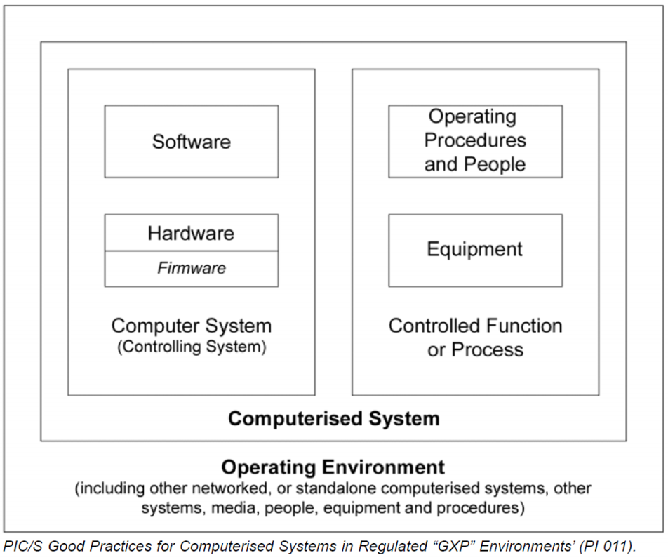
Computerised System Validation
A computerised system consists of hardware, software, underlying infrastructure (network components), interfaces, Standard Operational Procedures, System Documentation and people. Software itself is not a computerised system, but merely a part of such a system.

Slide 24
Computerised System Validation
Business Application is used to refer to the top most, customer facing layer. This layer undergoes “validation” and includes both customised and ‘commercial-off-the-shelf’ systems. Business applications are supported by the infrastructure platform layers which are “qualified”.
Business Application and Infrastructure layer relationship

Slide 25
Infrastructure Scope
Datacenters – Facility used to centralize IT Network Devices to include: servers, routers, switches, firewalls, load balancers, network accelerators, and storage disk arrays.
Can be client owned, 3rd party hosted, or “Cloud” services.
Includes data closets and server rooms
Network Devices – routers, switches, firewalls, servers, workstations, lab instruments, PLC’s, etc…
Infrastructure Tools - Active Directory, SCCM, VMware, Anti-Virus, Patching, Performance Monitoring, etc…
Infrastructure Platforms - “shared services” that support business applications: Backup & Restore, SharePoint, Citrix, Database Farms, etc…

Slide 26
QMS Hierarchy

Slide 27
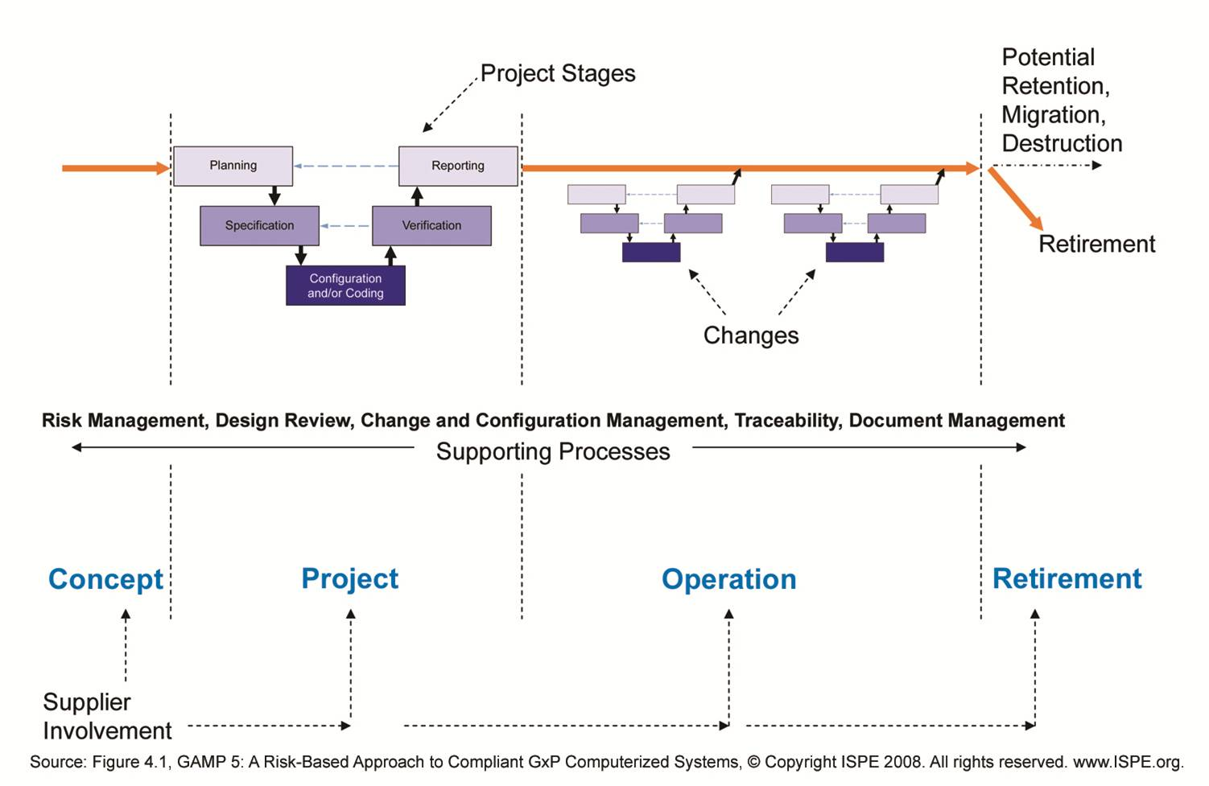
System Development Lifecycle Phases
Notes:
Validation is a PROCESS – it starts when the need for a computerised system is recognized and continues until that system is retired. Even when the system is retired, the data still “lives on” and either has to be migrated or archived in a format where it can be retrieved (unless the retention period has expired)
The Phases come from GAMP5 and are part of the Lifecycle Approach:
Concept phase includes initial Project Demand Management activities. These are not covered in this Training Overview.
Operation continues from first system release until the system is retired.

Slide 28
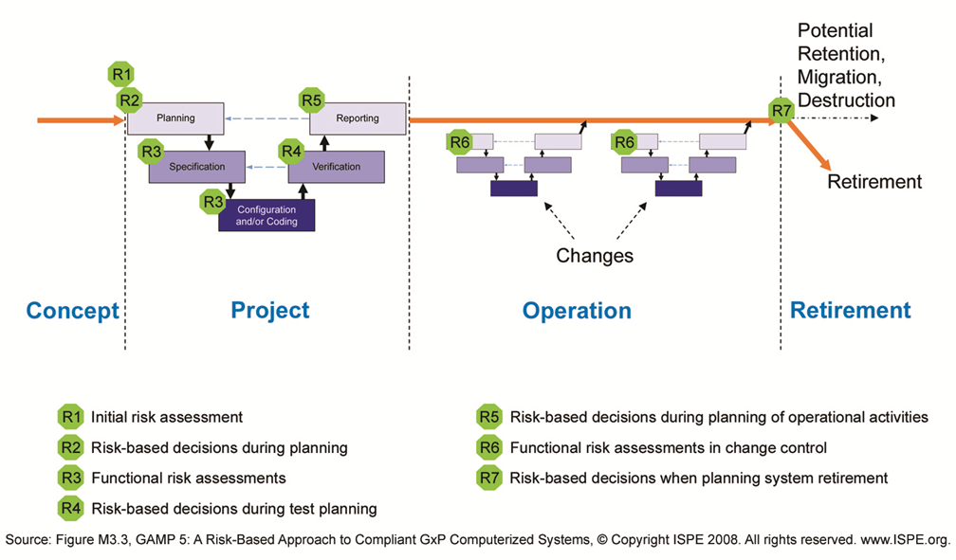
Quality Risk Management Applied to SDLC

Slide 29
Quality Risk Management Deliverables
Risk Assessment | Activity | Applicable Procedure | Applicable Template
R1 | Initial Risk Assessment (IRA) including GxP and Regulatory Assessments | Quality Risk Management | Initial Risk Assessment / Information Security Assessment
R1 | Architecture Impact Assessment (infrastructure only) | Quality Risk Management | Architecture Assessment
R2 | Validation Plan (VP) including GAMP Categorization OR Qualification Plan (QP) | Validation Planning, Reporting and Release Qualification Planning, Reporting and Release | Validation Plan Qualification Plan
R3 | Functional Risk Assessments (FRA) for Critical IRA items | Quality Risk Management | Functional Risk Assessment
R4 | System Test Plan (STP) | System Testing and Defect Management | System Test Plan
R5 | Risk-based decisions during planning of operational activities as documented in the Validation Report (VR) OR Qualification Report (QR) | Validation Planning, Reporting and Release Qualification Planning, Reporting and Release | Validation Report Qualification Report
R6 | Functional risk assessments in change control (business and/or technical) | IT Change Management | N/A
R7 | Risk-based decisions when planning system retirement | System Retirement, Decommissioning, and Disposal | System Retirement / Decommissioning / Disposal Plan

Slide 30
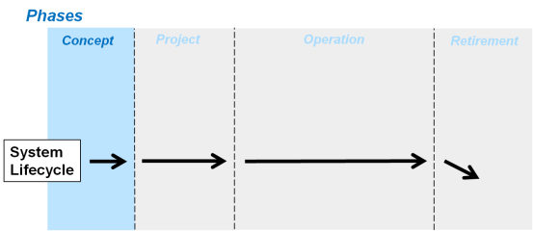
Concept Phase

Slide 31
Concept Phase
Business Process / Critical Process Parameter Development
Initial Risk Assessment
GxP Assessment
System Impact (patient safety, product quality, and data integrity)
Information Security Assessment
Architecture Impact Assessment
Supplier/Vendor Request For Proposal (RFP) and Quality Agreement

Slide 32
Business Process / Critical Process Parameter
A business process is a collection of related, structured activities or tasks that produce a specific business related goal
A Critical Process Parameter (CPP) is a process parameter whose variability impacts a quality attribute and therefore needs to be controlled to ensure the process produces the desired quality. A critical process parameter remains critical even if it is controlled.
Business processes are decomposed into sub-processes and documented following an established process and template
The Business Process documentation includes:
Process Flow Diagram
Workflow Description

Slide 33
Initial Risk Assessment
An Initial Risk Assessment (“R1”) is conducted against the business process or critical process parameter in order to determine criticality and GxP applicability. The outcome will be used as an input into the Validation Planning process (R2). The Validation Planning process will scale the project accordingly based on the results of the Initial Risk Assessment.
Critical
Business Critical – the process is critical to business objectives. Issues could cause business operations to be compromised, disrupted, or discontinued.
Quality Critical – the process is directly related to product quality, patient safety or data integrity.
Non-Critical
Those items that have not been designated at business or quality critical.

Slide 34
Information Security Assessment
An Information Security Assessment should be performed to ensure adequate controls are in place to ensure compliance with all Information security policies and regulations. Areas to consider include:
Physical Security
System Access Management and Password Control
Third Party Access
Privacy Laws
Electronic Messaging Systems
Shared Network Resources
Internet Access and Use
Mobile Computing Resources
Connectivity
Anti-virus Protection
Intrusion Detection
Patch and Update Management

Slide 35
Architecture Impact Assessment
The Architecture Impact Assessment is performed on all systems, including infrastructure. The servers, clients, devices and other software and hardware are listed in the Initial Risk Assessment. All software required for the system will be listed along with the data storage location and a rating of the complexity of the software/implementation. The information is provided by IT.
All IT Infrastructure are considered GAMP Category 1 systems
No GxP Assessment is performed, ALL Infrastructure components are qualified
Service Provider Assessments/Vendor Evaluations apply to Hosted datacenters, Enterprise Tools and Shared Services.

Slide 36
Supplier RFQ / Quality Agreements
Ensure that all initial business requirements and Quality Agreement requirements are built into the RFP that will be sent out to vendors/Suppliers. At a minimum these shall include the processes for the following:
Documentation Control
Training
Supplier Evaluations
Internal and External Audits
Sub-contracting controls
Change Management
Deviation Management
Incident Management
Regulatory Controls (Security, Audit Trails, Backup and Restore, Business Continuity Management and Disaster Recovery).

Slide 37
Project Phase

Slide 38
Stages in the Project Phase
Planning
Specification
Configuration & Coding
Verification
Reporting & Release
Each stage and associated
activities are covered in subsequent slides

Slide 39
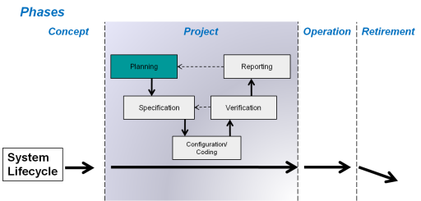
Planning Stage

Slide 40
Planning Stage Activities
Risk Assessments Completed
Required for all GxP computerised systems
Used to determine effort to be applied to the validation/qualification activities
IT Infrastructure (GAMP Cat 1) has a lower risk than the Business Applications that they support
User Requirements
Required for all GxP computerised systems
Infrastructure Requirements (IR) – Lists the installation and functional requirements of the infrastructure component.
Supplier Assessment
Required for all GxP computerised systems
Validation or Qualification Plan
Required for all GxP computerised systems

Slide 41
User Requirements
Gathering requirements starts with the clear understanding of what the system will need to accomplish. The Requirements Specification (RS) document defines “what” the system will do, therefore, it must be developed starting with the business processes, critical process parameters, and data flow diagrams
The requirements can be documented in the following ways:
A single document containing business and functional requirements traceable to business process flows.
A phased approach where user requirements are defined and later revised to include the functional requirements.
Separate User Requirements and Functional Requirements documents
Requirements combined with other deliverable documents where the complexity of the system does not warrant a separate document.
For complex or modular systems, multiple requirement specifications may be required to adequately identify user needs.

Slide 42
User Requirements
Requirements must be written to follow the SMART concept, Specific, Measurable, Achievable, Realistic and Testable. There needs to be a clear distinction between requirements that are critical versus non-critical which is an output from the Initial Risk Assessment
The following types of requirements must be considered:
Business Requirements
Data Requirements
Regulatory Requirements
Architecture / Technology (Infrastructure) Requirements
Performance Requirement
Interface Requirements

Slide 43
Risk Assessments
Phases
Concept
Project
Operation
Retirement
IRA
Planning
Reporting
FRA
TPRA
Specification
Verification
Configuration/ Coding
System
Lifecycle
IRA (R1) = Results from Initial Risk Assessment feed Validation Plan/Qualification Plan (R2)
FRA = Functional Risk Assessment (R3)
TPRA = Test Planning Risk Assessment (R4)
Notes:
Risk Assessment activities are performed at various stages of the project.
Each RA activity has a different scope and goal.
The overall goal is ensure the system has well defined and complete requirements, help with test planning, and scale the level of effort (rigor of testing and level of documentation) according to a risk based approach.
Risk should be managed throughout the project and it may be necessary to go back to a previous risk assessments and make adjustments if assumptions that were made are not proving true, e.g., if an assumption was made that the vendor did thorough unit testing so the client can focus at a higher level but a lot of defects are being found, etc. Need to add and address new risks that come up.

Slide 44

Risk Assessment Types
Type of Risk Assessment | Purpose and Timing
Initial (IRA) | Determines the overall validation strategy Risk control and mitigation exercise
Functional (FRA) | Determines the rigor of functional testing and documentation based on risk Performed at the requirements level after URS is approved
Test Planning (TPRA) | Determines level of testing based on risk Engages users in determining the scope and rigor of UAT Performed as part of test planning
Risk Assessments focus effort in the areas of highest risk
Notes:
Key differentiator between these various RA activities are:
IRA is a risk control and mitigation. It is a workshop activity. It helps set the Validation Strategy and also confirms no missing major area of requirements (for example: Do we have all the interfaces identified?)
FRA is intended to drive the test plan and set direction for rigor of testing and intensity of documentation. The well defined test plan will ensure all requirements are functionally tested and there is no “voyage of discovery” post Go Live. However, the rigor of testing and level of documentation can be scaled according to the Risk Priority assigned to the test.
The TPRA is intended to engage the users in a workshop atmosphere to define the type of scenarios that they would like to test and verify, before the Go Live. It is intended to be testing at the process level by the users. It should NOT become a repeat of the functional testing; using the same test scripts that were previously executed by IT Validation / Business Analysts.
By using this approach, we will also scale the rigor of testing and documentation (such as screen print), according to a risk priority number derived for the test case.

Slide 45
Supplier Evaluation Process
Risk Based Decision
- Based on Initial Risk Assessment
Public Information Assessment
Postal Assessment
On-Site Audit Assessment
Document Assessment or Produce Audit Report
Accept or Reject
Leverage Supplier Testing and Documentation
Periodic Re-Evaluation?
Notes:
A Supplier Assessment of an IT product or service supplier shall be conducted, based upon risk, e.g., when
New services/ products are being provided by the supplier
Periodic review requires a re-assessment of the supplier
An audit is requested by internal management for a specific reason
A Basic Assessment is an audit in which a checklist is used for the evaluation of the supplier’s capabilities
A Paper Audit is an audit in which the supplier is sent a precompiled questionnaire
An On-site Audit is an assessment that is conducted at the supplier’s location utilizing a precompiled checklist.
Once suppliers have been accepted, they may be subject to periodic re-evaluation. Periodic re-evaluation can be performed by a basic assessment, paper audit, or an on-site audit.
During the assessment identify if any supplier testing or documentation can be utilized rather than repeating the same work.

Slide 46
Validation Planning
Determine the activities that need to be performed and documentation required to ensure that the computerised system is fit for its intended use.
Define the Validation Planning, Reporting and Release process:
GxP systems require all of the deliverables defined in the SDLC Procedure based on GAMP Category.
Notes:
If the result of the GxP assessment is GxP = YES, validation planning follows the standard validation process.
Validation activities and deliverables may be scaled back, if the result of the GxP assessment is GxP = NO.

Slide 47
Validation Planning
Validation Plan must be developed for all Projects that deliver or significantly modify a Computerised System
The Validation Plan can be scaled according to:
GAMP5 Categorization
GAMP Category 3, 4, or 5 (non-configurable, configurable, custom)
Results of the Initial Risk Assessment
System impact on patient safety, product quality and data integrity
Architecture Impact Assessment
Information Security Assessment
Outcome of the supplier assessment
Notes:
The approaches for GxP and non-GxP systems both seek to minimize the total cost of ownership of the system across the life-cycle, but Validation Planning for GxP systems is cognizant of the demands of the regulators to generate and maintain ‘objective evidence’ of validation activities, such that can be shown to inspectors during a regulatory inspection.
The validation plan needs to clearly specify the activities required to validate the system; who is responsible and involved in those activities; and what documentation is required.
When it has been written and approved there should be no surprises during the project phase, i.e., activities that have been forgotten, documents that people didn’t know they had to write, etc. It takes time to write it correctly and think through the overall strategy for the validation since every system and every release will be different.
If the project requires new infrastructure components, the VP needs to refer to a Qualification Plan where these activities are detailed (unless they are minor when they could be included in the VP)

Slide 48
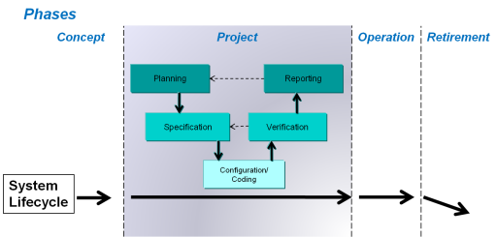
Qualification Planning
A Qualification Plan is used to define:
The purpose and scope of the qualification activities
The roles and responsible parties of the qualification activities
The deliverables required for the qualification
How the qualification documentation will be managed
The approvers of the qualification documentation
The training required for the qualification participants
The acceptance criteria of the testing activities

Slide 49
Qualification Planning: Datacenters
Datacenters that contain/host infrastructure components must be qualified.
Qualification verifies:
Physical layout and labeling
Fire Supression systems
Power distribution and emergency power
Environmental Monitoring
Temperature and Humidity ranges
Flood
Physical Security
Badging, access lists, access logs

Slide 50
Qualification Planning: Network Devices
Network Devices must be qualified
Qualification of devices verifies:
An approved design specification for the device
The installation of each device via a standard IQ
The general operation of each device via a standard OQ
Qualification of devices captures:
An initial design specificaiton
Installation instrucutions
Initial Configuration
Repetative Network Device qualifications are candidates for “Standard“ Changes.

Slide 51
Qualification Planning: IT Tools and Platforms
IT Tools and Platforms will be independently qualified
Each Tool and/or Platform will have an associated design specification
Each Infrastructure Tool and/or Platform will have a unique set of requirements that will be recorded, approved, then verified.
Installation requirements will not be less than the manufacturer‘s recommended minimums.
Operational requiremenrts will focus on the “high-level“ functionality and/or reporting of the associated Tool or Platform.
Going forward, each time changes are made to the Tool or Platform, the design and requirements are updated and approved to accomodate the change.

Slide 52
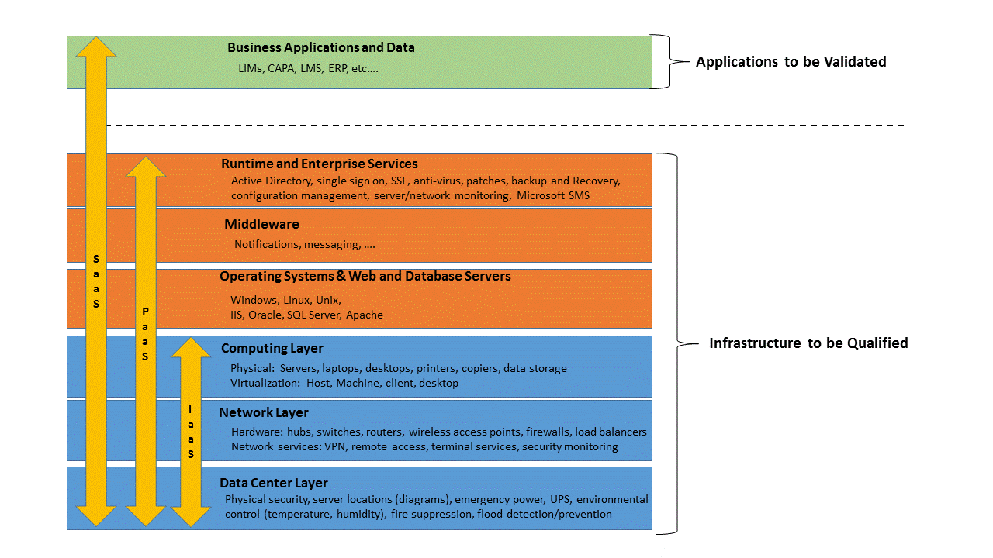
Qualification Planning: “Cloud”
Infrastructure “as a Service” has the same qualification requirements

Slide 53
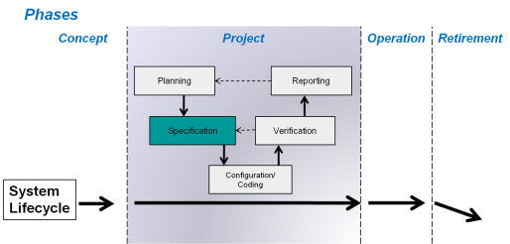
Specification Stage

Slide 54
Specification Stage Activities
Functional Specification
Required for all Category 4 & 5 systems
May be combined with Requirements Specification for smaller systems
Configuration Specification
Required for all Category 4 & 5 computerised systems
Design Specification
Required for custom components of Category 4 & 5 systems
Required for all Infrastructure Qualification Projects (Technical Design Specification)
Infrastructure Requirements
Required for all GxP computerised systems

Slide 55
Specifications
Types of Specifications | Purpose | Required for GAMP S/W Category Components
Functional Specifications (FS) | Translates RS into technical language for development | Category 4, 5 (configurable, custom)
Configuration Specifications (CS) | Translates RS into technical options to allow the configuration of the software | Category 4, 5 (configurable, custom)
Technical Design Specification (DS) | Translates FS into detailed design for coding | Category 4, 5 (configurable, custom) Category 1 (infrastructure)
Infrastructure Requirements | Specifies all hardware and software components for the computerised system including a system architecture diagram | Categories 1, 3, 4, 5 (infrastructure software, non-configurable, configurable, custom)
Notes:
At a minimum, all validated systems must have a RS with Software and Hardware Requirements.
We are moving away from the term FRS. If there is functional requirement to be documented, it should be done at the RS level.
Functional Specifications are required for custom developed software (Category 5), and should not contain requirements.
Technical TDS is only required for the customized components of the system.

Slide 56
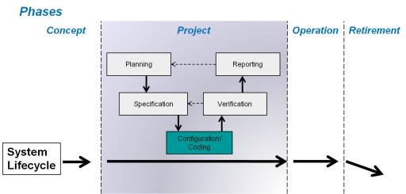
Configuration/Coding Stage

Slide 57
Configuration & Coding Stage Activities
Functional Risk Assessment
Determine the rigor of System Testing
See Risk Assessments
Software Development
Applicable only to custom components of Category 4 & 5 systems
Design Review
Applicable only to Category 5 systems
Traceability Matrix
Initial mapping of Business Processes to Requirements, and Requirements to Functional Specifications
See Traceability

Slide 58
Configuration, Software Development, Design Reviews
For GAMP Category 4 (configurable) system components
The components are configured against the Configuration Specification
For GAMP Category 5 (custom) system components
Design Reviews evaluate the design against standards and requirements, identifying issues and proposing corrective actions
Software Development utilizes standards for naming conventions and programming practices, where available
Notes:
Where required, configuration is generally performed as part of the installation verification. The application must be installed in conformance with manufacturer’s specifications and configured in accordance with the client configuration specifications.

Slide 59
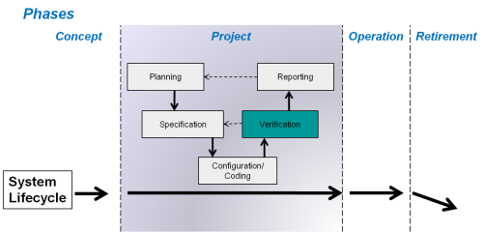
Verification Stage

Slide 60
Verification Stage Activities
GAMP Good Practice Guide “A Risk Based Approach to Testing for GxP Systems”
Test Planning and Test Management including Risk Assessment (R4)
Develop System Test Plan outlining test strategy, environments, test execution and results recording, and defect management process.
Test types may include the following and should be based on GAMP Category and results of Risk Assessment:
Static Testing
Structural Testing
Installation Verification
Functional Testing
Performance Testing
Challenge Testing
Regression Testing

Slide 61
GAMP GPG Test Types
Test | Usage
Static Testing | Design Reviews, Source Code Reviews, Configuration Testing
Structural Testing | The objective of structural testing (or white-box testing) is to ensure that each program statement performs its intended function and may include Decision (Branch) Coverage, Condition Coverage, Loop Coverage, Path Coverage, and Data Flow Coverage
Installation Verification | Verification of the Installation in the Test and Production Environments.
Functional Testing | Functional Testing verified the functional requirements and should be based on risk and scaled accordingly. Testing may include Normal Case (Positive) Testing, Invalid Case (Negative) Testing, Business Process Testing, Special Case Testing, Output Testing, and Combination Testing.
Performance Testing | Environmental Testing, Accuracy Testing, Repeatability Testing, Load and Capacity Testing, Usability Testing.
Challenge Testing | The objective of challenge testing is to evaluate the robustness of a system or component under abnormal operating conditions including Data Validity Testing, Security Testing, and Stress Testing,
Regression Testing | The scope of all regression testing should be based upon regression analysis to determine the scope of functionality potentially affected by the change and should reflect both the risk priority associated with the system or function and the likely impact of the change being made.

Slide 62

Test Intensity Determined by the results of the FRA and TPRA
Test Intensity | Description
Intensive Risk Priority = High | Positive & Negative testing (as required, including multiple/alternate path testing) Formal, pre-approved test scripts Objective evidence is required (e.g. screen-shots, logs, or reports), including tester initials and date Independent review of objective evidence required
Standard Risk Priority = Medium | Positive testing, including multiple/alternate path testing Formal, pre-approved test scripts Hand written result (screen-shots or other evidence are optional) and tester initials and date Independent review of results, checking for completeness and compliance
Minimal Risk Priority = Low | Vendor testing or leverage vendor documentation Testing guided by checklists (including tester initials and date per test) Pre-approval of checklists is not required Review not required, except for confirmation by a 2nd person to ensure testing is performed. For low prioritized simple configuration changes, screen-shots (before and after) can be used instead of checklists or test cases. Initial and date must be added on the screen shots. The System Operational Procedure needs to describe the changes for which this is applied.

Slide 63
Defect Management
Defects are a divergence from expected results during testing.
Unless otherwise specified:
If an error is encountered during the installation and/or configuration of a component prior to IQ/OQ verification, this error can be corrected without the need to log it in a Defect Management system (Updates to FS, DS and/or CS may still be required).
All defects encountered during testing will be documented, investigated, and have an approved mitigation.
All defects will be summarized in the associated Test Summary Report or Validation/Qualification Report (as defined in the Validation/Qualification Plan).
For outsourced systems, the service provider will provide testing defects to the client for review. The review will verify that all defects have been closed/mitigated and are listed in the Validation/Qualification Report.

Slide 64
Data Migration
Data Migration Planning, Specification, and Reporting
Data Migration is the activity of transporting data (electronically or manually) from a source to a target computerised system
Required if historical data is being migrated into the new system
The formality of Data Migration processes shall be scaled according to the complexity and volume of the data migration task
For small, simple migrations deliverables can be combined or documented in the Validation Plan and Validation Report
Larger initiatives would require a separate Data Migration Plan and Data Migration Report
All business and data transformation rules as defined in the Data Migration Specification must be tested.
Notes:
Not all projects involve Data Migration activities.

Slide 65
Data Migration Deliverables
Validation Plan
Sample Size:
Data Migration Plan
Q-Env
P-Env
Data Migration Specification
Data Migration Test Summary Report
Q-Env = Quality Environment
P-Env = Production Environment
Validation Summary Report
Notes:
The DM Plan defines the strategies that will be deployed to identify, extract, manipulate, migrate and verify all data that is migrated from one or multiple source systems to target system(s)
The DM Summary Report summarizes the results of the Data Migration activities
The DV Plan outlines the procedure for verifying the accuracy and integrity of the data migration process from the source system(s) to the target system(s). There could be multiple DV Plans if there are many types of data to migrate.
Each DV Plan will be executed in the Quality environment as well as the Production environment but the sample size used for Production should be smaller since detailed verification already occurred in Quality.
Each type of data migrated requires the Data Owner to approve that it has been migrated successfully via Data Migration Approval Sheets.
There will be a DV Report for each DV Plan executed in Quality and another one for the DV Plan executed in Production.
Aspects of data migration occur throughout all Project Stages since there are aspects of planning, specification, potentially coding, verification, and reporting.

Slide 66
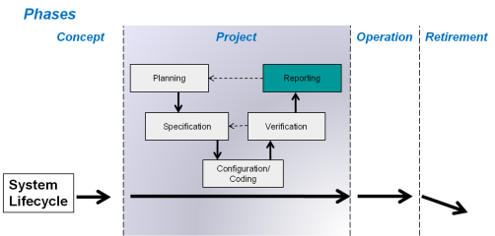
Reporting & Release Stage

Slide 67
Reporting & Release Stage Activities
Validation/Qualification Report
Required for all GxP computerised systems
Service Level Agreements
Required for all GxP computerised systems
System Description
Required for all GxP computerised systems
Handover Process
Required for all GxP computerised systems

Slide 68
Validation Report
Validation Report structure shall mirror the corresponding Validation Plan
It will summarize the validation activities performed, any deviations from the plan, any outstanding and corrective actions, and a statement of fitness for intended use of the system
Notes:
Approval of the Validation Report indicates that the system meets business requirements and it is fit to be released for operational use.
The report mirrors the validation plan with the addition of spelling out how the validation status will be maintained during the Operation Phase until the system is retired, i.e., what procedures are in place for operation and maintenance of the system.

Slide 69
Qualification Report
A Qualification Report (QR) will be created for each Qualification Plan or System Test Plan.
The Qualification Report will summarize the qualification activities performed, any deviations from the test or qualification plan, any outstanding and corrective actions, and a statement of fitness for intended use.

Slide 70
System Description
System Description provides an overview of the application, including regulatory impact, principles, objectives, security measures, interfaces and the main features of the computerised system
A System Description is required for all GxP computerised systems utilized in a formal business process
Notes:
The System Description must be reviewed for accuracy with every change to the system and updated, as required
The System Description is specifically required by EU Annex 11: Computerised Systems

Slide 71
Cutover Process
The Cutover process defines the controls required for the transition of a computerised system from the Project Phase to the Operation phase
The process ensures that the production environment is prepared in order to ensure that the system can be used and supported in a controlled manner
The cutover process is specified in the Validation/Qualification Plan and reported upon in the Validation/Qualification Report
Notes:
The Cutover process spans the Project and Operation phases

Slide 72
Cutover Requirements
Project and Validation/Qualification Activities are completed
Document Management and Archiving controls are in place and required documentation is managed accordingly.
Operational and Support Organizations are in place and roles defined
System Management, Use, Administration and Support Processes are in place
Support Services are defined (Service Level Agreements)
System Users, Administrators and Support organizations are trained
Data Setup is complete (including any cutover activities)
Residual Risks and Issues are handed over to user and support organizations

Slide 73
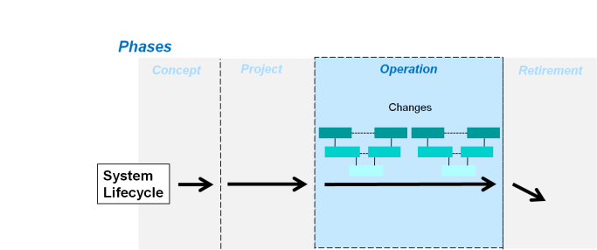
Operation Phase
Notes:
Once the system is released, the system lifecycle moves from the Project Phase to the Operation Phase.
The Operation Phase shows the same “V” stages as the Project Stages in the Project Phase – only they occur more often. Each time a changes is required, the same V stages may need to be considered:
Planning for the change
Specifying what the change will be
Making the change
Testing/verifying the change
Reporting the change, i.e., closing out the change documentation

Slide 74
Operation Phase
Keeping the system in the validated state post project phase
System Operational Procedures
One for each computerised system or infrastructure platform, device or tool.
Details which operational practices apply to that system
Can reference other documents or include specific details
Where procedures differ for global systems across sites, all procedures will be specified
Allows for gradual introduction of operational processes over a period of time
Change Management
Periodic Review
Notes:
Operation is the longest phase of all and it is essential to follow controlled operational practices to ensure that the system remains validated.
The “System Operational Procedure” is a new deliverable and it documents what those controlled practices are for a specific system.

Slide 75
System Operational Procedure
The System Operational Procedure covers the following:
Establishing and Managing Support Services (SLAs)
System Administration
Performance Monitoring
Incident Management
Problem Management
Service Request Management
Operational Change and Configuration Management
Patch Management
Backup and Restore
Archiving and Recovery
Business Continuity and Disaster Recovery
Security Management
Must be maintained throughout the life of the System

Slide 76

Training of Support Staff
System / Platform Owner ensures adequate training for maintenance, operation and support staff
Training is preferably managed in the Learning Management System

Slide 77
IT Change Management Procedure
Establishes a global procedure for recording, documenting and managing changes to IT computerised systems
Includes IT Change Request and Change Control
Ensures that changes are implemented in a consistent way and maintain the validated state of the computerised system
The procedure describes the process. It is software-tool neutral
Provides the ability to add repetitive qualifications to a “Standard” pre-assessed/pre-approved list of components to facilitate accelerated qualifications.
Defines an Emergency Change Management Process

Slide 78
Change Management Process
Changes to all GxP systems are documented and approved in accordance with the IT Change Management process
Initiation of Change Request
Impact Analysis and
Risk Assessment
Change Request
Review and Approve Change Request
Development & Testing by IT
User Acceptance Testing
Change Control
Change Control Approval
Implementation
Change Request / Control Closed

Slide 79

Periodic Review
Regularly evaluates the compliance status of the whole system.
Includes a review of multiple system records, processes and procedures.
Conducted throughout the operational life of a computerised system.
Performed in accordance with a pre-defined process and documented with corrective actions.
Activities scaled according to category, complexity and novelty of the system.

Slide 80
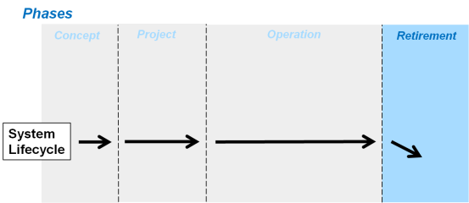
Retirement Phase
Notes:
Final phase of the system lifecycle

Slide 81

Retirement Phase
The retirement of Computerised Systems shall be managed in accordance with a System Retirement / Decommissioning / Disposal Procedure
A system specific plan must be developed and approved prior to initiating the retirement activities
The plan needs to consider the archiving, retention, migration or destruction of data and the verification process used to support it.

Slide 82
Retirement Phase
Business Applications can be Retired or Decommissioned
Retired: A system is no longer active for new information but is still available (in a reduced state of access/functionality) for reporting and archival.
Decommissioned: A system is removed from the network, disposed of, or re-purposed.
The Business Owner leads the Retirement activities to include:
Application concerns, reduced access, data migration, record retention, etc…
Infrastructure Owner leads the Decommissioning activities
final backups, limiting access, removing servers from service, server disposal, etc..

Slide 83
Validation/Qualification Deliverable Approval Matrix (RACI) - Legend
Responsible (“Au” or “R”) This role identifies the “doers” of the process task. They should complete the task. Several individuals can be jointly responsible. Author role might be delegated, but defined Author per Matrix also needs to approve. Signs as “Au” for “Author”, who is principally responsible for creating a document. Signs as “R” for “Responsible” for approving the document.
Accountable (A) This person is the “owner” of the related tasks. This person should make sure that the roles and responsibilities are assigned and ensure that the resource is provided. There is only one person accountable for each task (where a system supports more than one business process the accountability for the system can be shared). This role is also responsible for approving the document.
Consulted (C) These are the people who need to give input before the work can be completed, during the execution of the work and at approval. These people are active participants in the process and may be consulted, but do not necessarily have to approve. The level of formality of consultation is determined by the Accountable person.
Informed (I) Roles needing to be informed won't be documented in the Approval Matrix, but might be requested within defined Procedures.
Notes:
The Validation Deliverable Approval Matrix indicates roles and responsibilities for the various deliverables.
Responsible and Accountable must sign
There is only one person as Accountable, while there can be multiple people as Responsible.
If Consulted signs, signs as Reviewed By
Informed does not sign – informed can be anyone

Slide 84
Quality Management System Deliverables Approvals Matrix
QMS Documentation Tier Level vs Roles and Responsibilities | Tier 1 - IT Compliance Manual | Tier 2 - Policies | Tier 3 - SOPs, Standards | Tier 4 - Guidelines, Templates, Forms, Work Instructions
Author | Au | Au | Au | Au
Chief Information Officer | A | R | I | I
Business Process Owner |  |  | R | R
System Owner |  |  | I | I
IT Compliance | R | A | A | A
QA (GxP Systems) | R | R | R | R

Slide 85
Validation Approvals Matrix
Project Validation Deliverables vs Roles and Responsibilities | Business Process Development (BPD) | Initial Risk Assessment (IRA) | Functional Rick Assessment (FRA) | Architecture Impact Assessment | Information Security Risk Assessment | Requirement Specification (RS) | Functional Specification (FS) | Validation Plan (VP) | Supplier Assessment Public Information Audit | Supplier Assessment Postal Audit | Supplier Assessment On-Site Audit | System Test Plan (STP)
Business Analyst | C |  |  |  |  | Au
Business Process Owner | Au, A | C, R | R |  | R | A | I | R | Au, R | Au, R | R
Data Owner |  |  |  |  | R | R |  | R
Information Security and Risk SME |  |  |  |  | Au, A | R |  | R
Project Manager | I | I | I | I | I | I | I | I | I | I | I | I
IT Compliance | R | R | R | R | R | R | R | Au, A | C | C | C | A
Quality (for GxP only) | R | R | R | R | R | R |  | R | A | A | Au, A
System Owner |  | Au, A | A | Au, A |  | R | A | R | R | R | R | R
Technical Subject Matter Expert | C | C | Au | C |  |  | Au | C |  |  |  | C
Test Lead |  |  |  |  |  |  |  |  |  |  |  | Au
Tester
Notes:
notes to cover:
1. The Validation Plan or System Operational Procedure can define if people that have multiple roles sign only in one of the roles. It must be specified in which of the roles they sign 2. At least two independent individuals have to sign a document
3. Black Wavy line indicates this is just a sample and there are more documents.

Slide 86
End of Presentation

